Slide 1
OETC
February 9-11, 2016
https://goo.gl/EdNuvk

Slide 2
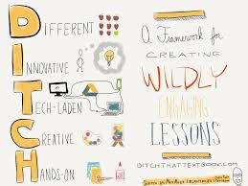
Going Textbook-less
Stephanie DeMichele, M.A.
Instructional Technology Specialist for Wickliffe City School

Slide 3
Fun Formative Assessments
Jaime Chanter
Lakewood City Schools
@JChanter22
jngannon22@gmail.com

Slide 4
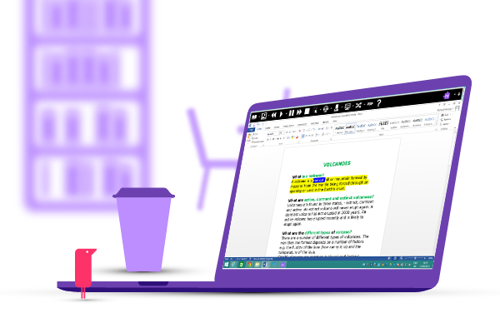
Read & Write
Teachers get the app for free by typing in www.tinyurl.com/freerwg

Slide 5
Using Twitter for Education

Slide 6
Teaching Math with Google Drawings

Slide 7
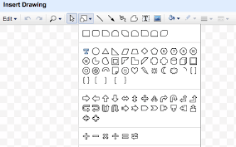
Google Drawings - 5th Grade Samples

Slide 8
What's New and Good to Great with Google for Education

Slide 9
Creating Student-Centered Environment to Accommodate Learners in Mathematics

Slide 10
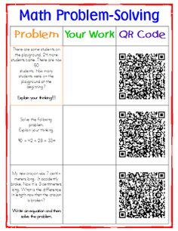
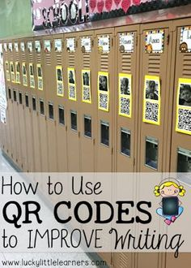
QR Codes
Exit Tickets
Scan Homework out the door
Scavenger Hunt
Exit Tickets

Slide 11
Resources

Slide 12
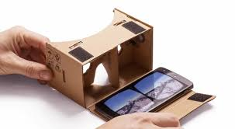
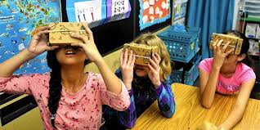
Google Expeditions

Slide 13
Our Google Classroom: the good, bad, and the ugly

Slide 14
Google Training for Educators

Slide 15
Google Educator Group of Ohio

Slide 16
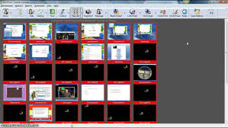
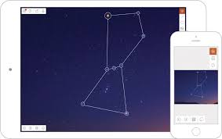
Apollo vs. LanSchool

Slide 17
Jaime Casap, Chief Google Education Evangelist
Iteration and Innovation
VideoNot.es
Opening General Session

Slide 18
Girl Coders, Kent City Schools
Girl Coders Slide Presentation

Slide 19
Hadi Partovi, Code.org Founder
“Our schools should be teaching computer science.”

